Slide 1
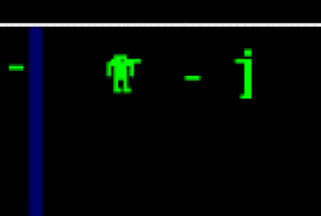
Berzerk

Slide 3
Your boss LOVES Berzerk!
Multi-player
You can upgrade you gun to a heat seeking missile
You drop your “regular” ray-gun, you pick up the missile launcher
You also have to pick up rockets
The robots can also pick up the rocket launcher (once they see you shoot it)
You can get roller skates (to go faster)
If you are hit once, then your skates fall off
Also there are stronger robots sometimes.

Slide 4
Inheritance: “Is a”
If an object “is a” type of another object, then use inheritance
RayGun “is a” weapon
MissleLanucher “is a” weapon
AVOID: “has a” relationships

Slide 5
cRayGun:
std::string colour;
Shoot();
cWeapon:
glm::vec2 position;
glm::vec2 velocity;
bool isShot;
Int shoesize;
Shoot();

Slide 6
cRayGun:
std::string colour;
Shoot();
vTable()
cRayGun:::Shoot()
cWeapon::shoot()
cWeapon:glm::vec2 position;
glm::vec2 velocity;
bool isShot;
Int shoesize;
Shoot();

